Slide 1
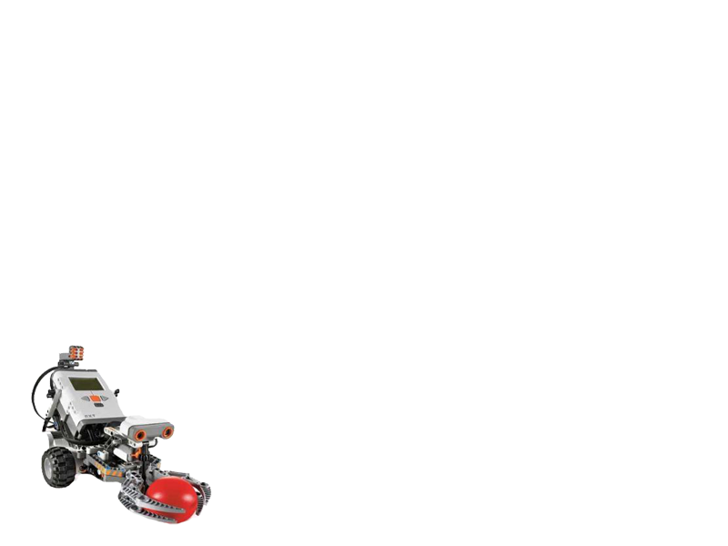
Final Year Project
Lego Robot Guided by Wi-Fi (QYA2)
Presented by:
Li Chun Kit (Ash)
So Hung Wai (Rex)

Slide 2
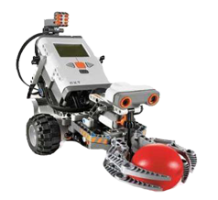
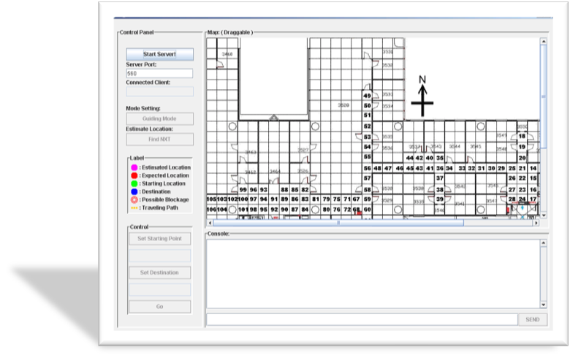
Overview
Introduction
Video Demo
System Functions
- Localization
- Self-Guiding
- Obstacles Detection
- Auto Data Collection
Conclusion
Q&A

Slide 3
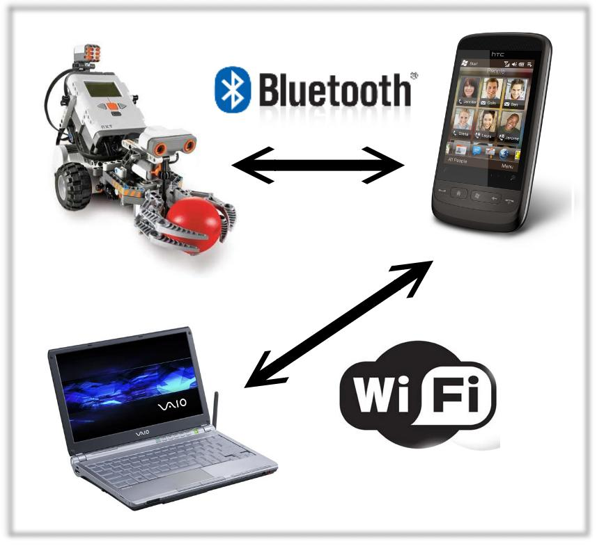
Introduction
Goals
Wi-Fi Indoor localization
Self-Guiding
Lego robot as the media
to move and collect data
automatically
Figure 1. The client-server architecture.

Slide 4

Video Demo

Slide 5
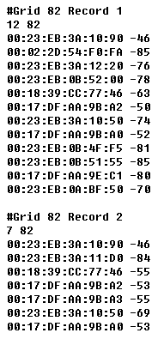
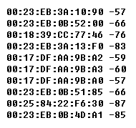


Localization
Offline Phrase | Online Phrase
Data collected for establishing the training database | Observed data is compared with the training database
Figure 3. Observed data received during online phrase.
Machine Learning Algorithm
Estimated Location
Figure 2. Records in training database.

Slide 6
Localization :
K-Nearest Neighbor (KNN)
Classification by computing similarity between unknown object and known objects.
c
c
a
c
a
c
Unknown Objects | Observed Data O( o_{1,} o_{2,} o_{3,} ……o_{k} )
Known Objects | Training Data T(t_{1,} t_{2,} t_{3,} ……t_{m} )
a
a
K=10
K=4
b
b
b
Figure 4. For k=4, the user trace is classified to be grid c record; while it is classified to be grid a when k=10.
Estimated Location | The grid cell having the highest occurrence in the k coverage
a
Euclidean Distance
Records in grid a, band c
b
c

Slide 7

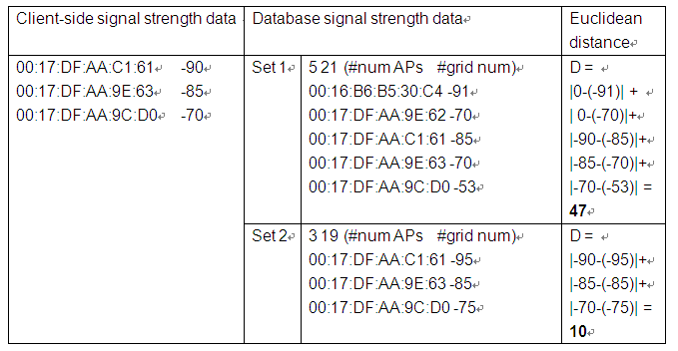
K-Nearest Neighbor (KNN)
In Practice
Figure 5.
Computing Euclidean Distance
Euclidean Distance is calculated for each records in training database

Slide 8
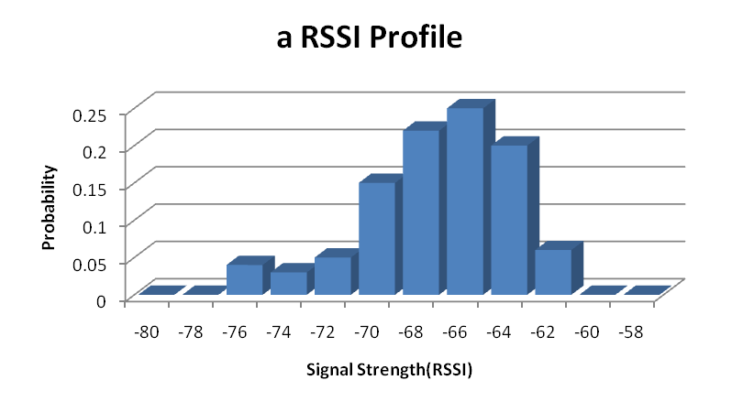

Localization:
Bayesian Probability
Bayesian approach is based on signal strength distribution of access points on each grid cell.
mitigates the random errors
adopts probability measurements
Figure 6. A histogram showing the RSSI distribution of an access point at a grid cell
computes across 106 grid cells

Slide 9
In Practice
Bayesian Probability
Mac Address |  | RSSI probability
 |  | -60 | -58 | -56 | -54 | ……
 | 00:17:DF:AA:9B:A2 | 0.00 | 0.00 | 0.02 | 0.10 | ……
 | 00:23:EB:0B:4F:F5 | 0.02 | 0.11 | 0.25 | 0.20 | ……
 | 00:23:EB:0B:51:55 | 0.01 | 0.23 | 0.18 | 0.02 | ……
 | …… | …… | …… | …… | …… | ……
Grid Cell 82
RSSI Profiles
Mac Address |  | RSSI probability
 |  | -60 | -58 | -56 | -54 | ……
 | 00:23:EB:0B:4F:F5 | 0.20 | 0.24 | 0.10 | 0.03 | ……
 | 00:23:EB:3A:12:20 | 0.00 | 0.00 | 0.05 | 0.08 | ……
 | 00:17:DF:AA:9E:C1 | 0.01 | 0.02 | 0.13 | 0.18 | ……
 | …… | …… | …… | …… | …… | ……
Grid Cell 83
RSSI Profiles

Slide 10
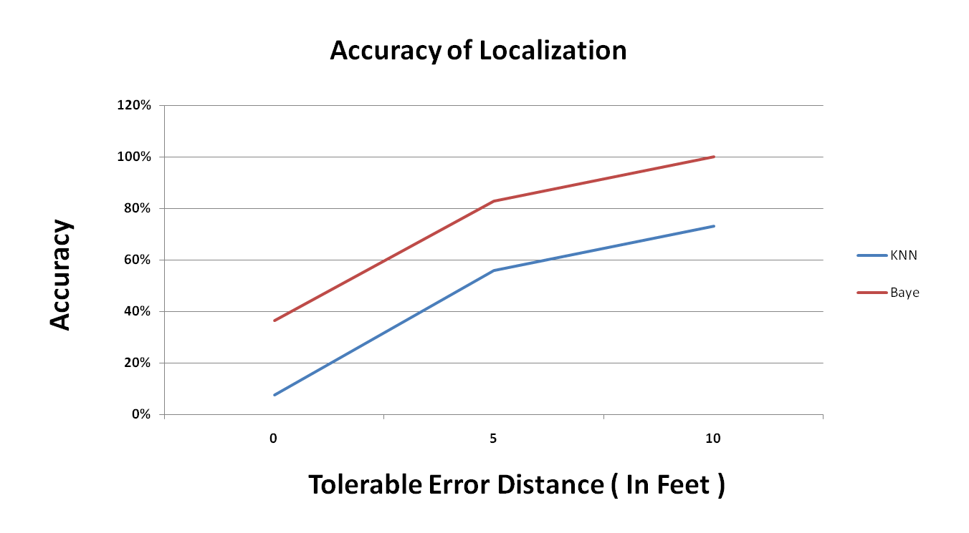
Algorithm Accuracy

Slide 11
Appendix
KNN Demonstration

Slide 12
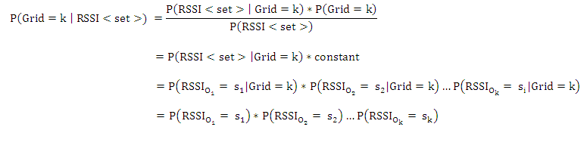
Appendix
Bayesian Formula

Slide 13
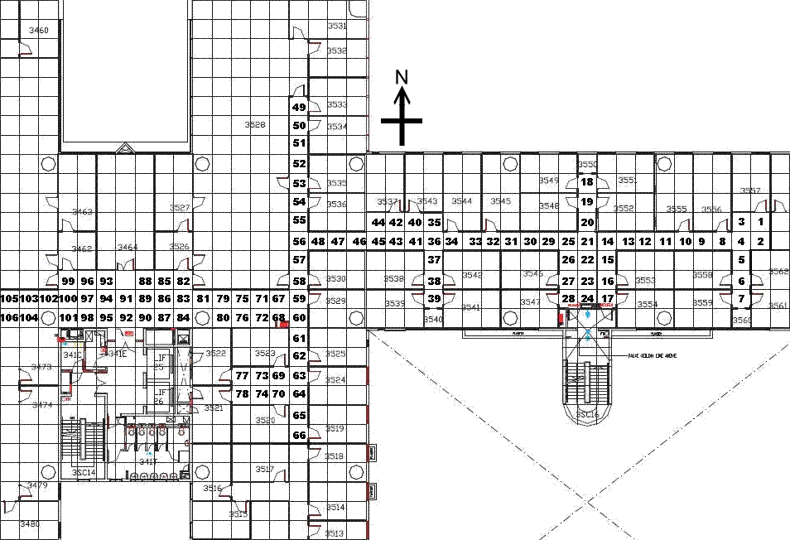
Appendix

Slide 14
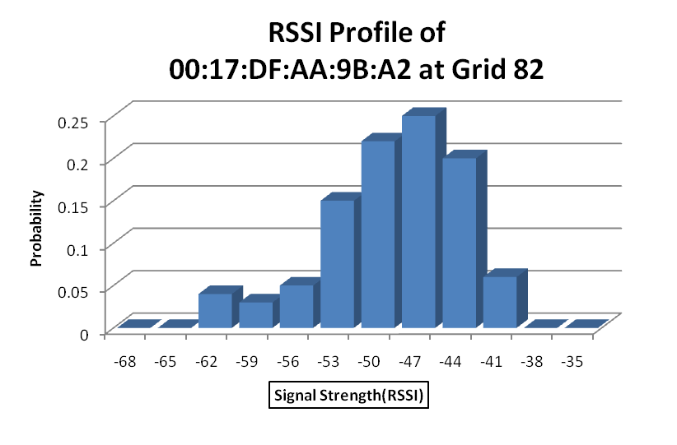
Intuitively
Figure 2. Records in training database.
Bayesian Probability

